Slide 1

Image Compression Based on Non-Parametric Sampling in Noisy Environments
Kishan Narotam Nitesh Nana
Supervisor: Professor Fambirai Takawira

Slide 2
Why?
Research-based
Potential new method for image compression
DCT → JPEG
DWT → JPEG-2000

Slide 3
Outline
Objectives and Specifications
System Overview
System Implementation
Results & Analysis
Future Work
Conclusion

Slide 4
Objectives and Specification
Create a robust image compression scheme
Create holes in the image
Encode the image
Introduce random errors
Filling the holes
Time frame: 6 weeks
Budget: R1 200

Slide 5
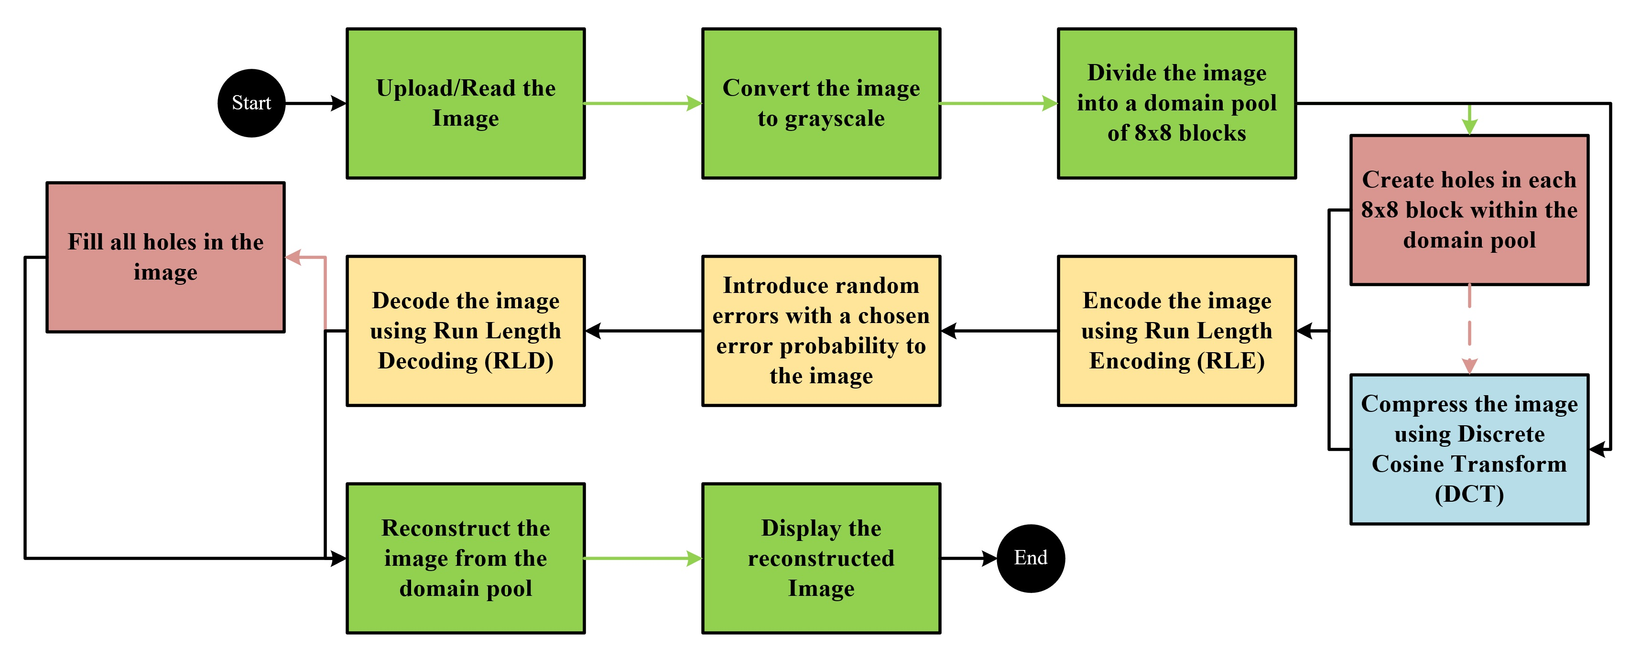
System Overview

Slide 6
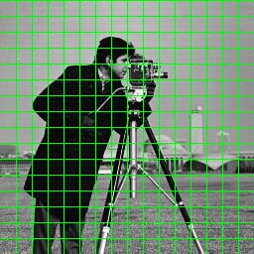
System Implementation (Initial Steps)
Reading an image:
Height
Width
Colour map
8-bit unsigned integers
Converting to grayscale:
Height
Width
Create the domain pool

Slide 7
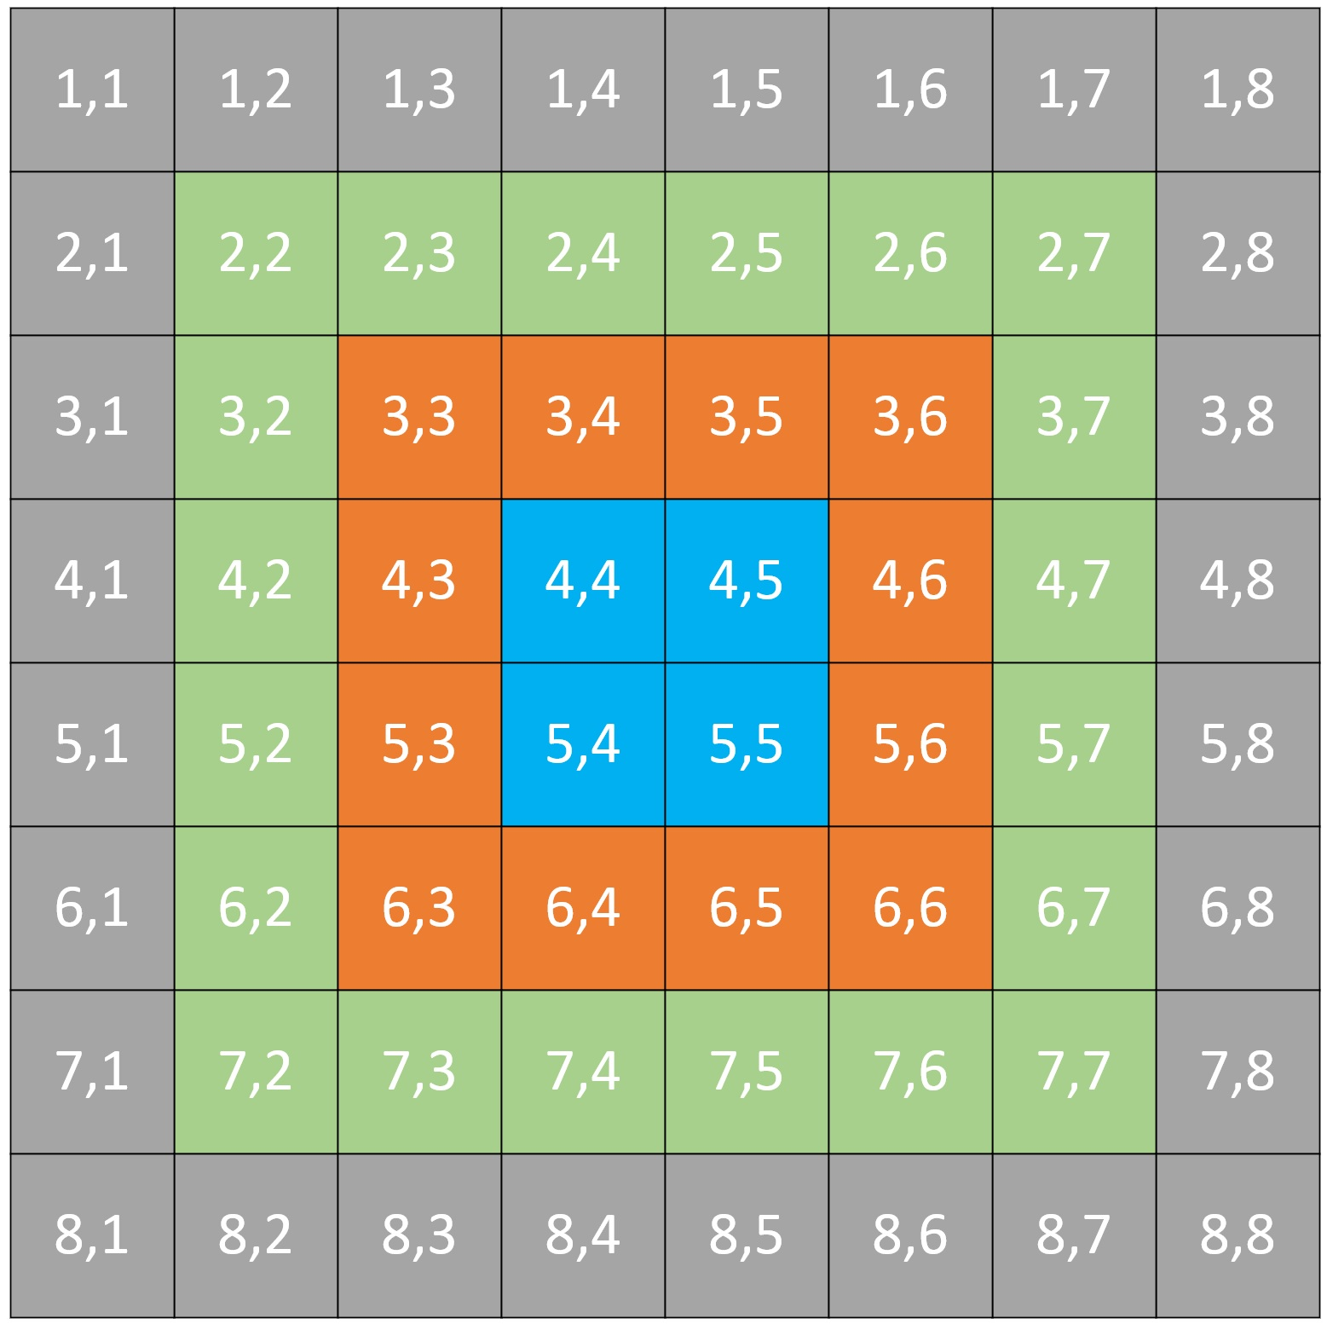
System Implementation (Creating the holes)

Slide 8
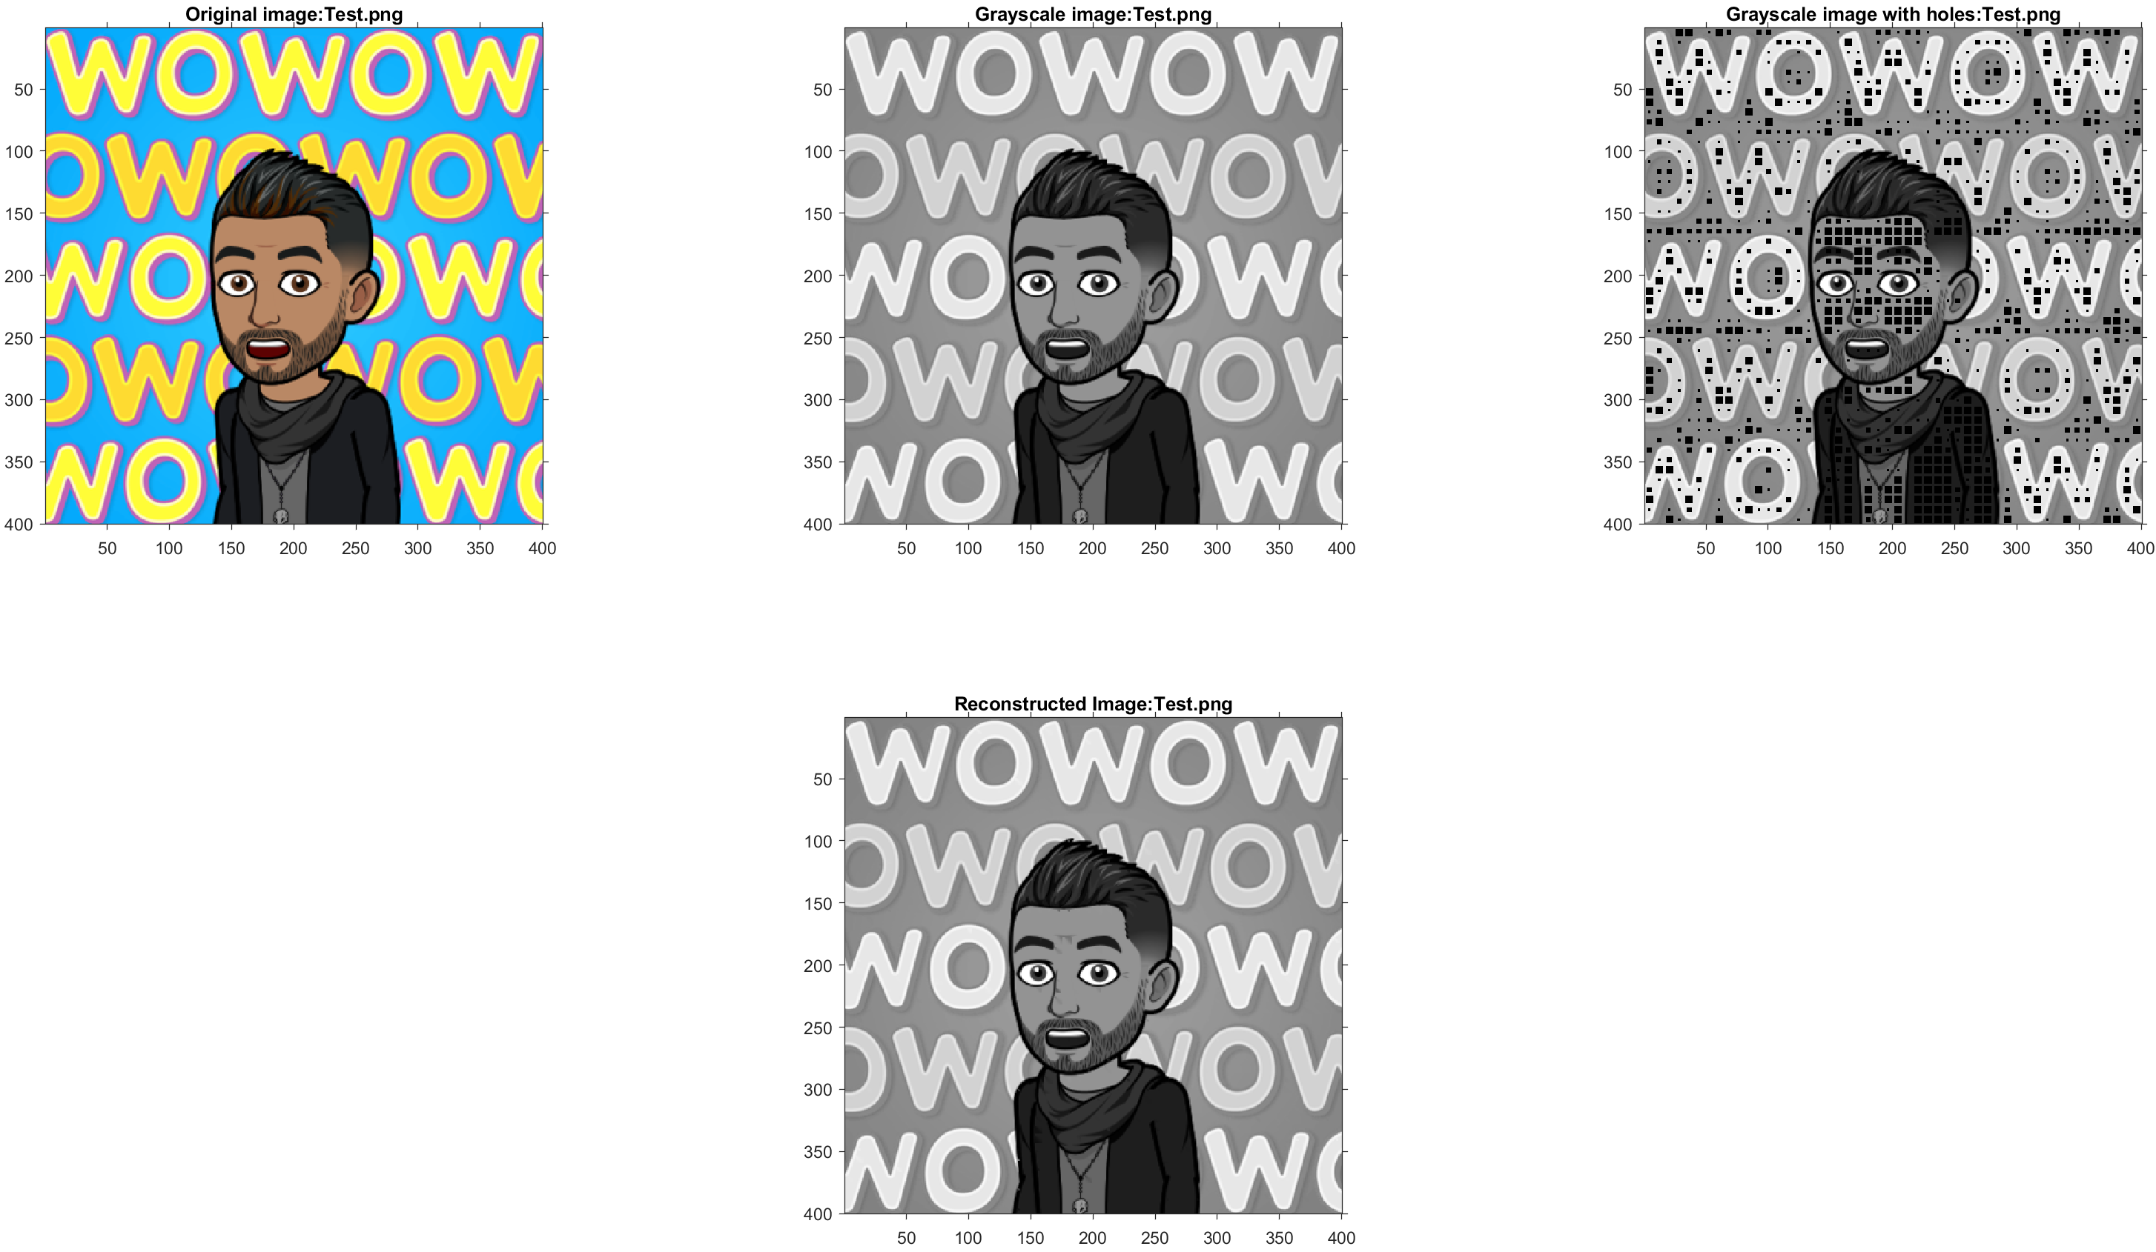
Chebyshev Distance = 1

Slide 9
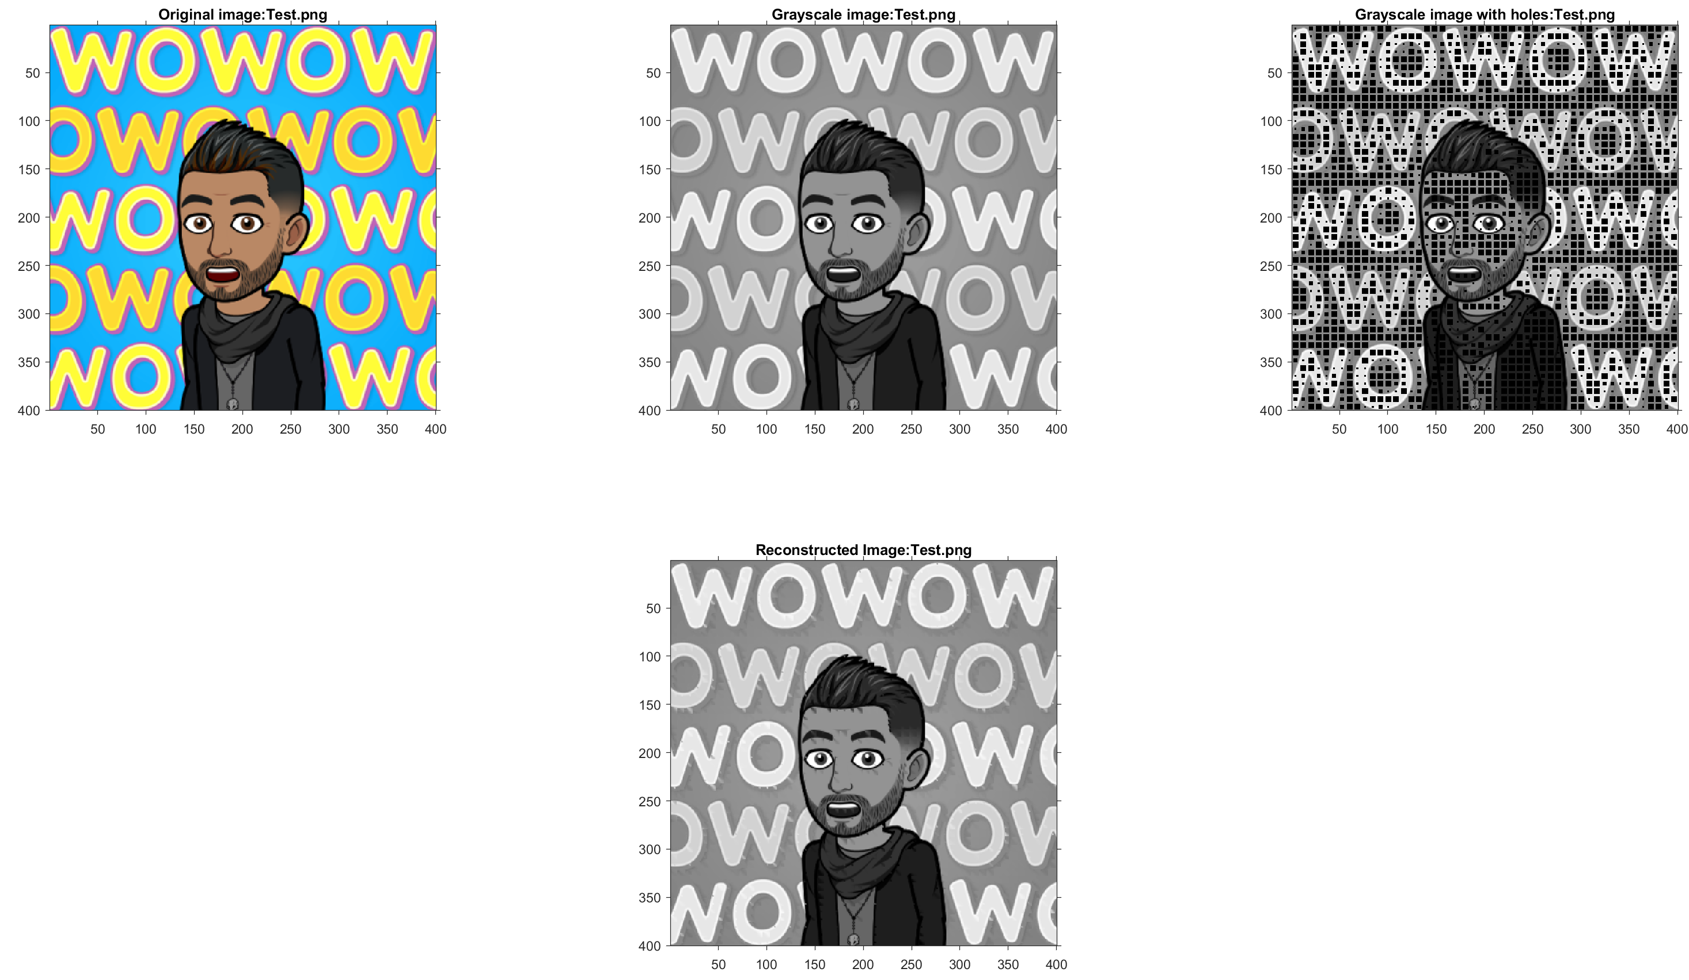
Chebyshev Distance = 10

Slide 10
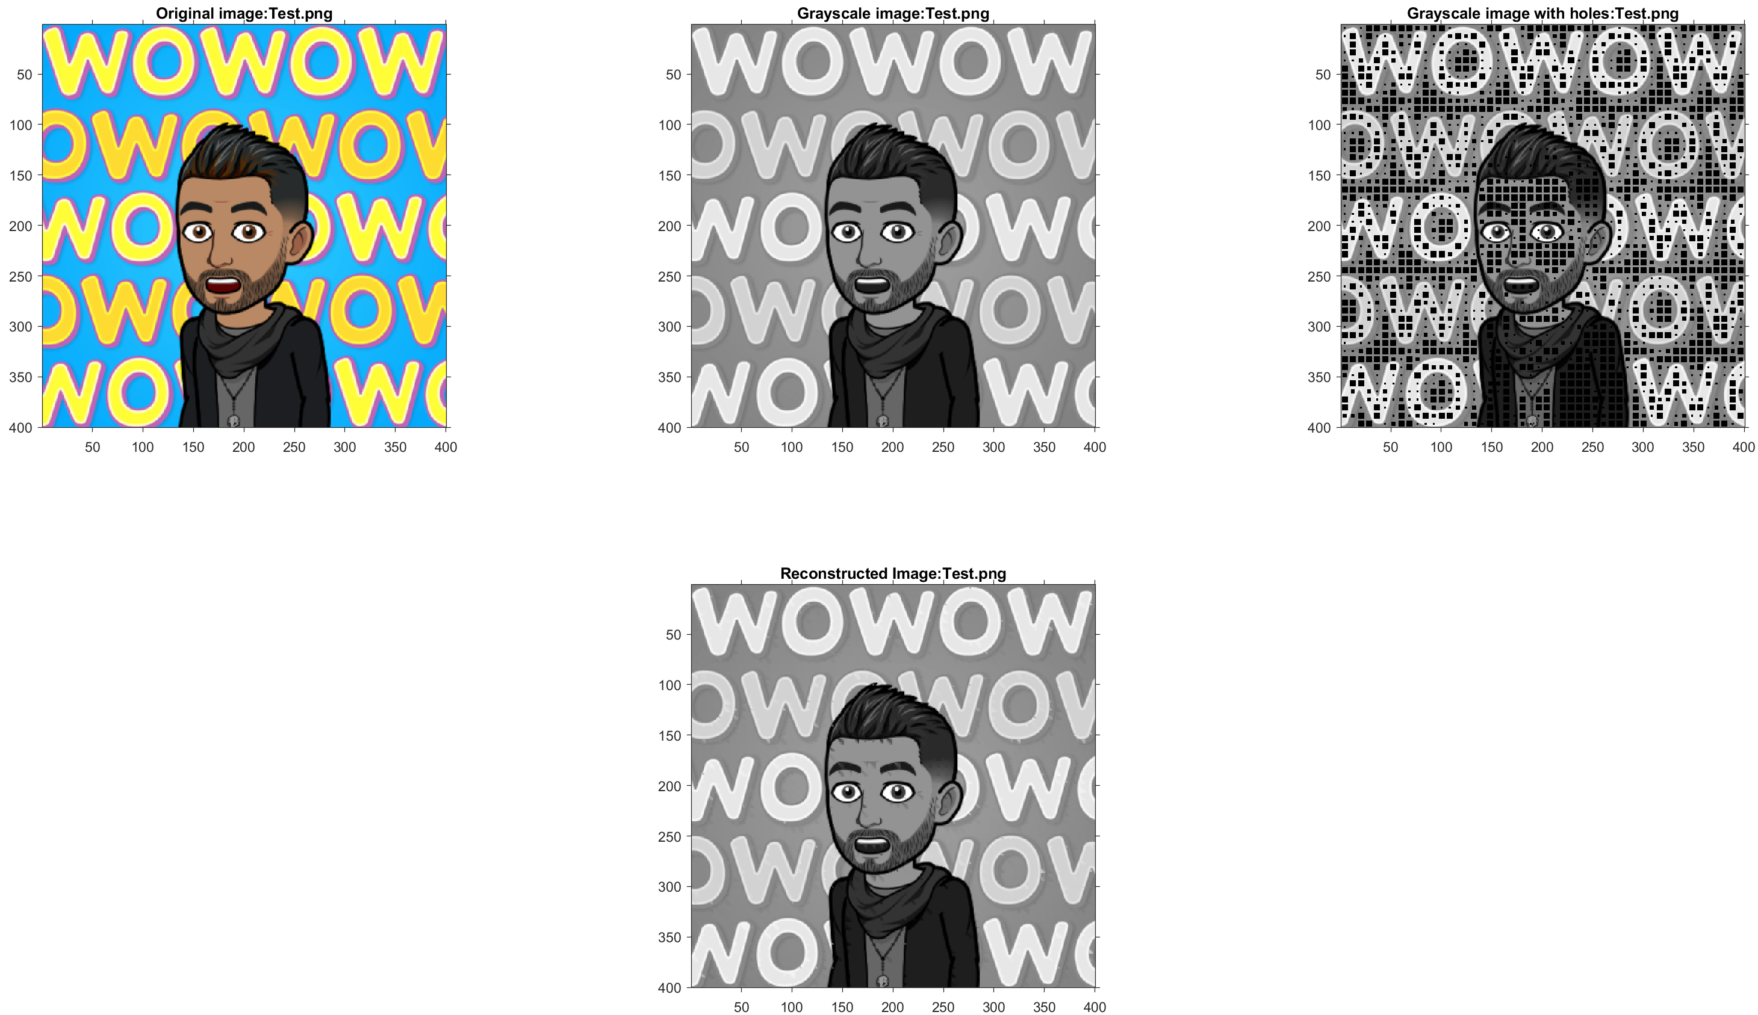
Chebyshev Distance = 6

Slide 11
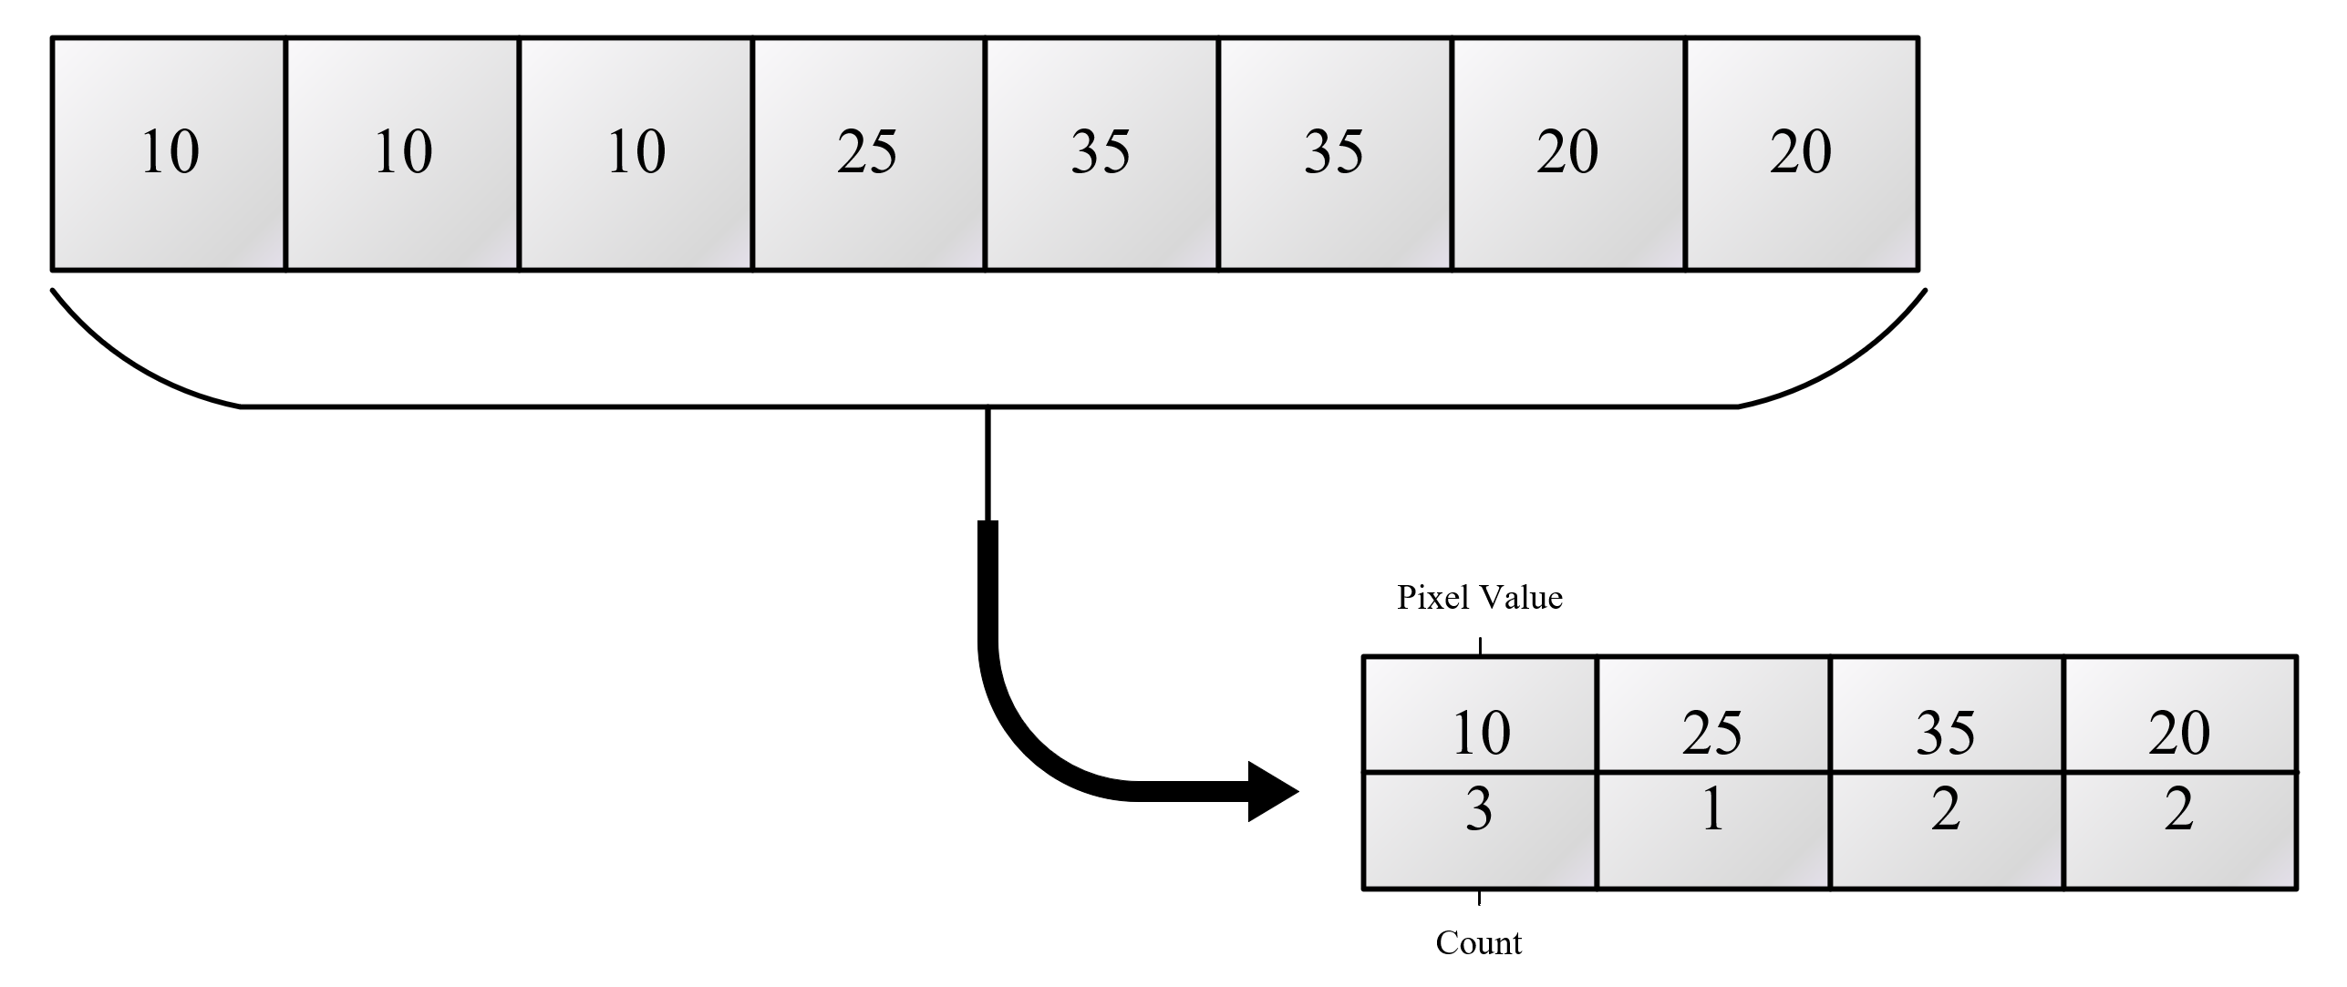
System Implementation (Encoding)
Run Length Encoding
10 → 0000 1010
10 → 1010

Slide 12


System Implementation (Error Introduction)
Bit flip
62 → 11 1110
Fourth bit to be flipped
11 1010 → 58
Ones Compliment
62 → 11 1110
Ones compliment
00 0001→ 1

Slide 13
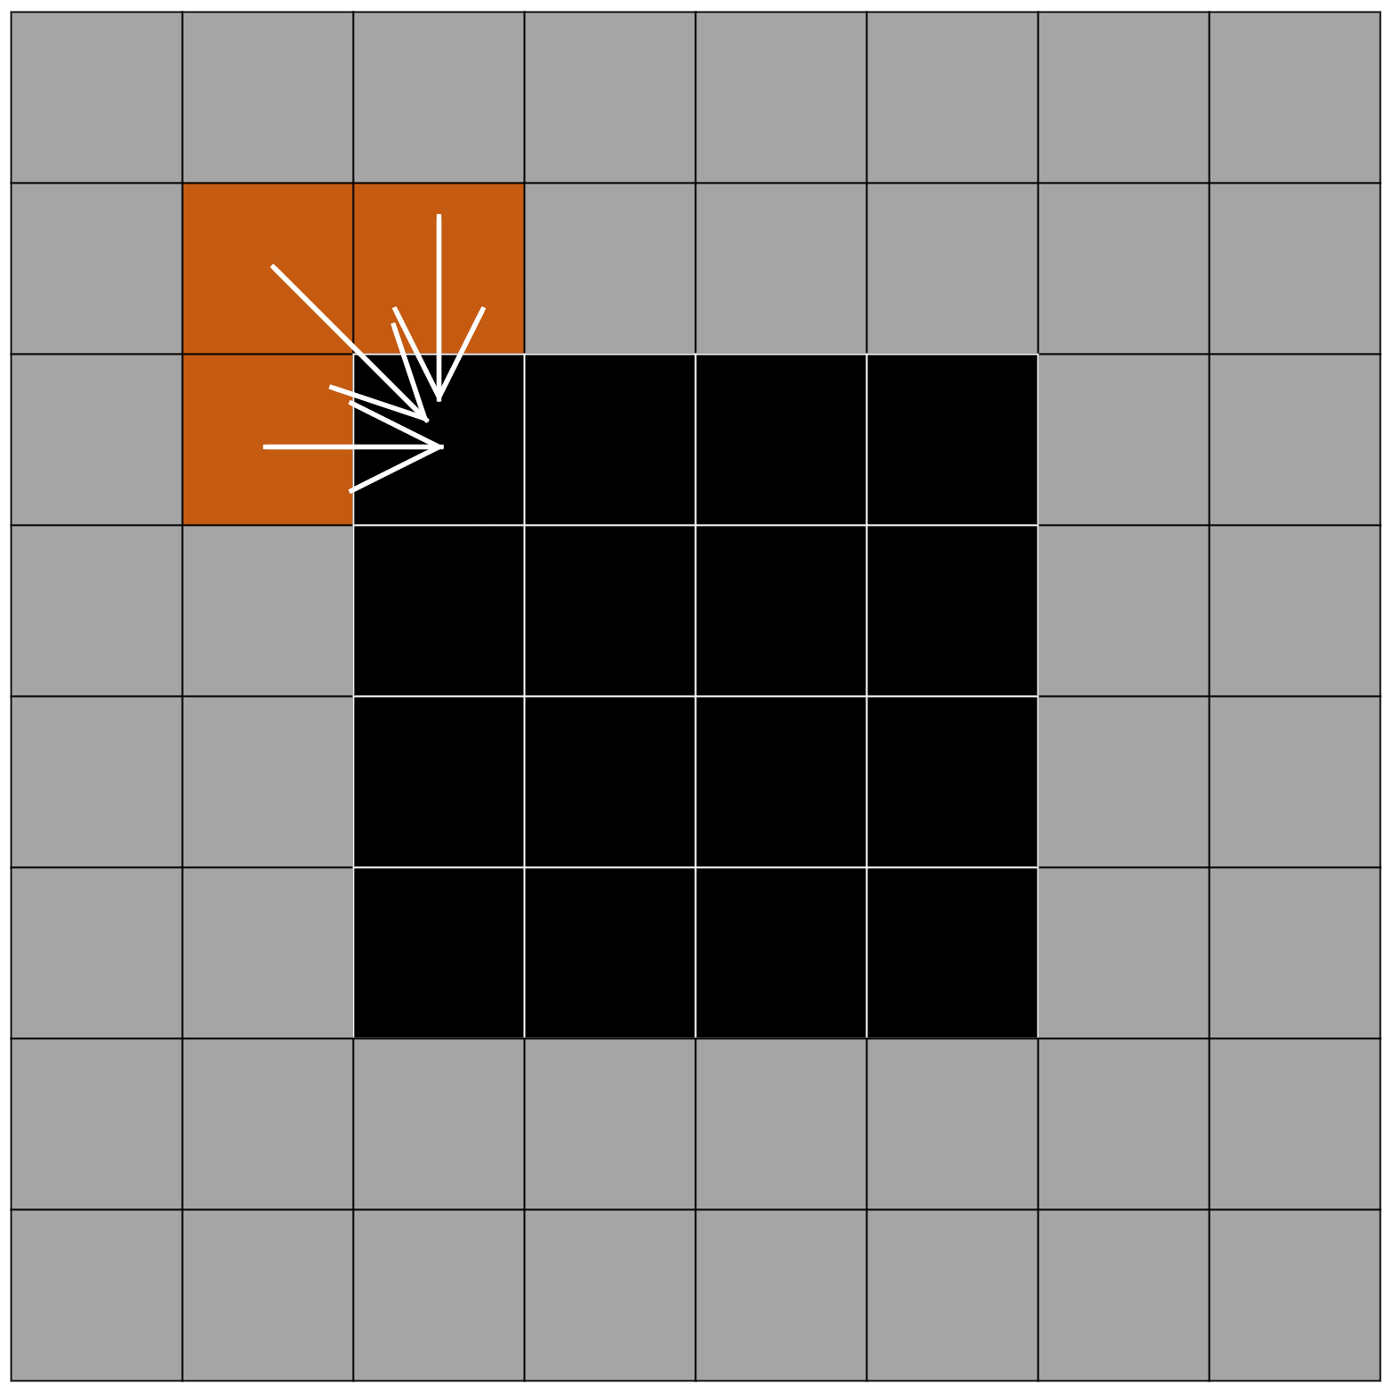
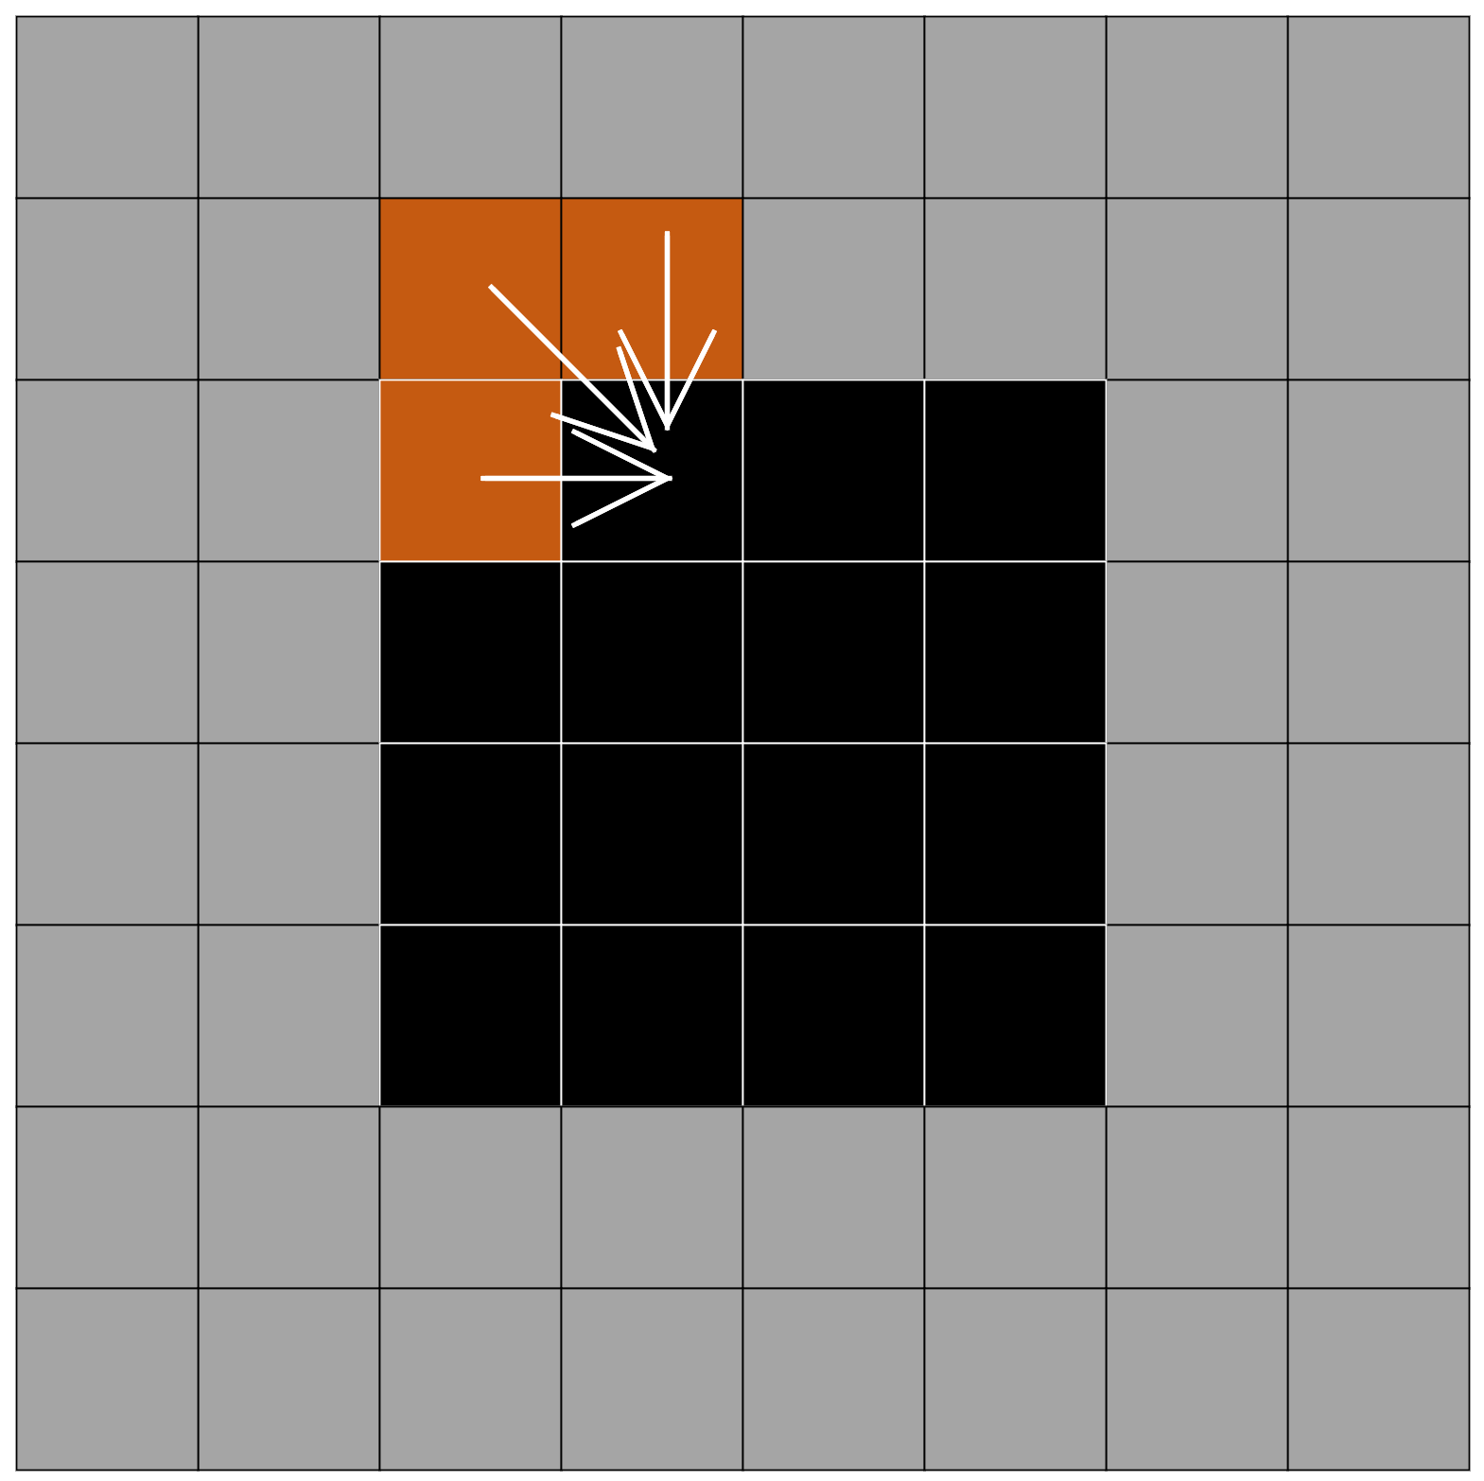
System Implementation (Filling the Holes)
Current literature → pattern matching
Created method → averaging method

Slide 14

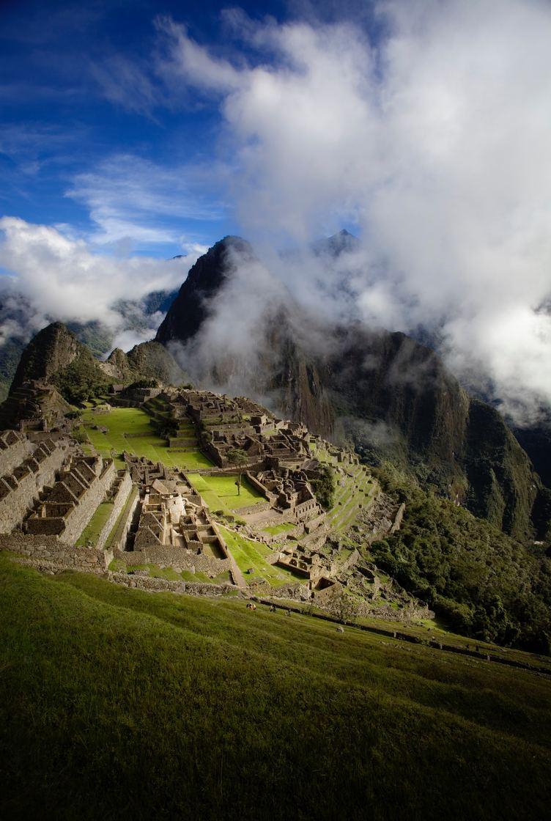
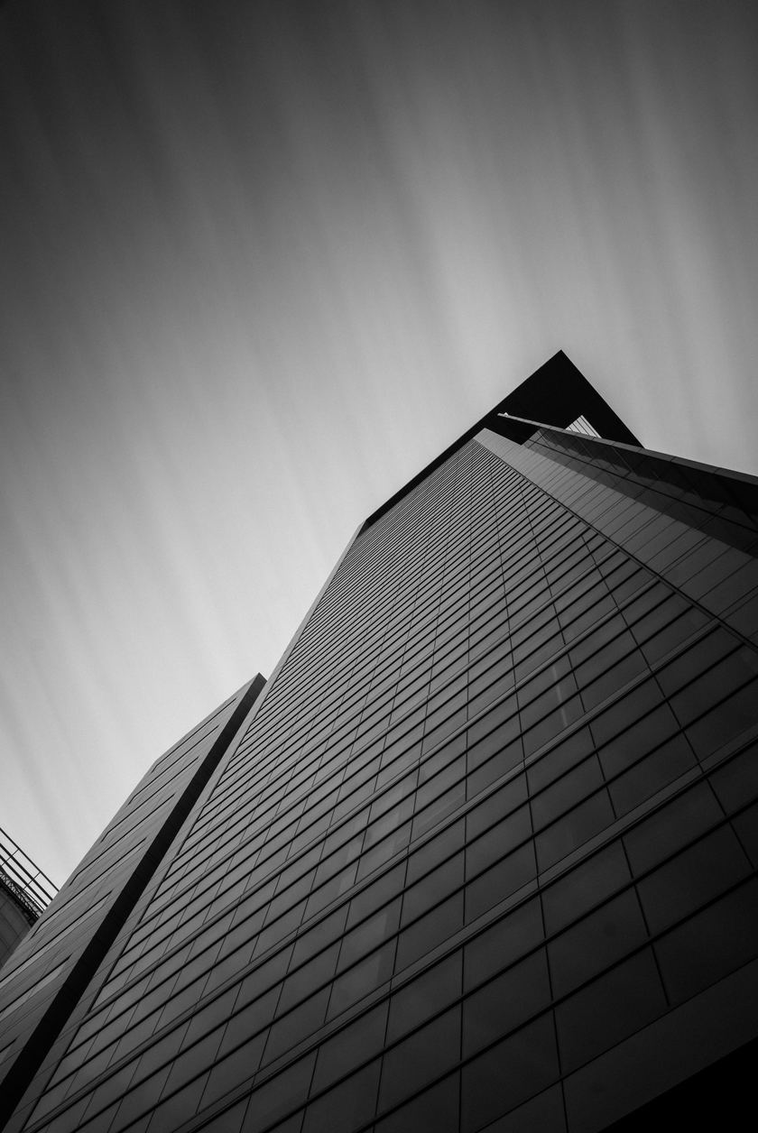
Results & Analysis
Pattern
Landscape
High Contrast

Slide 15

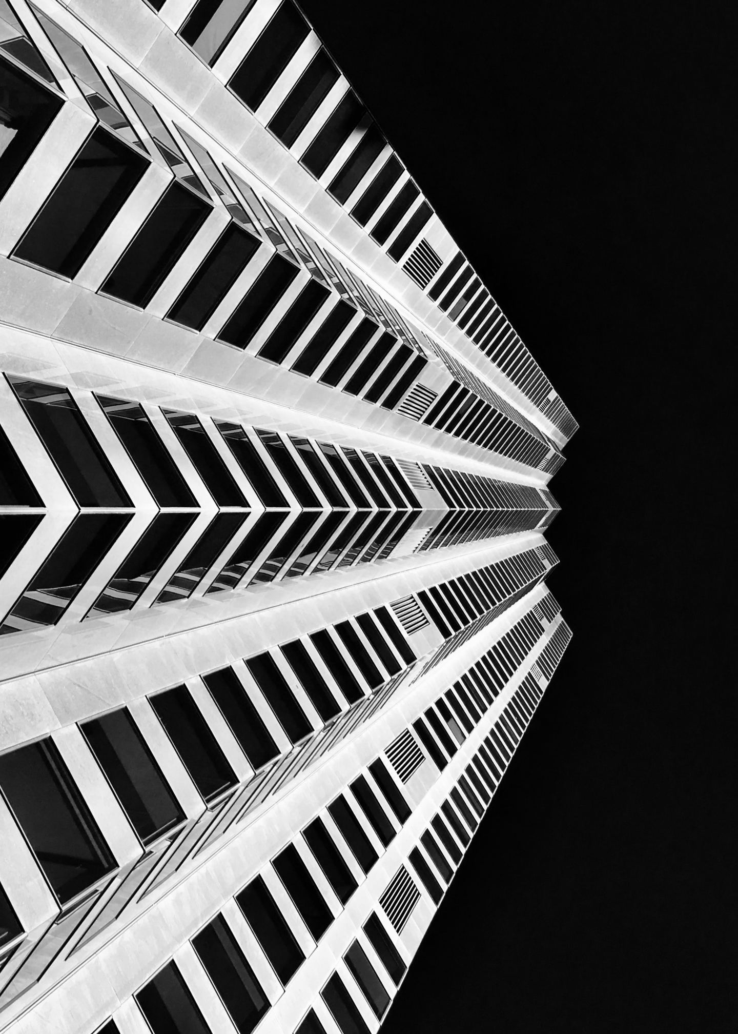
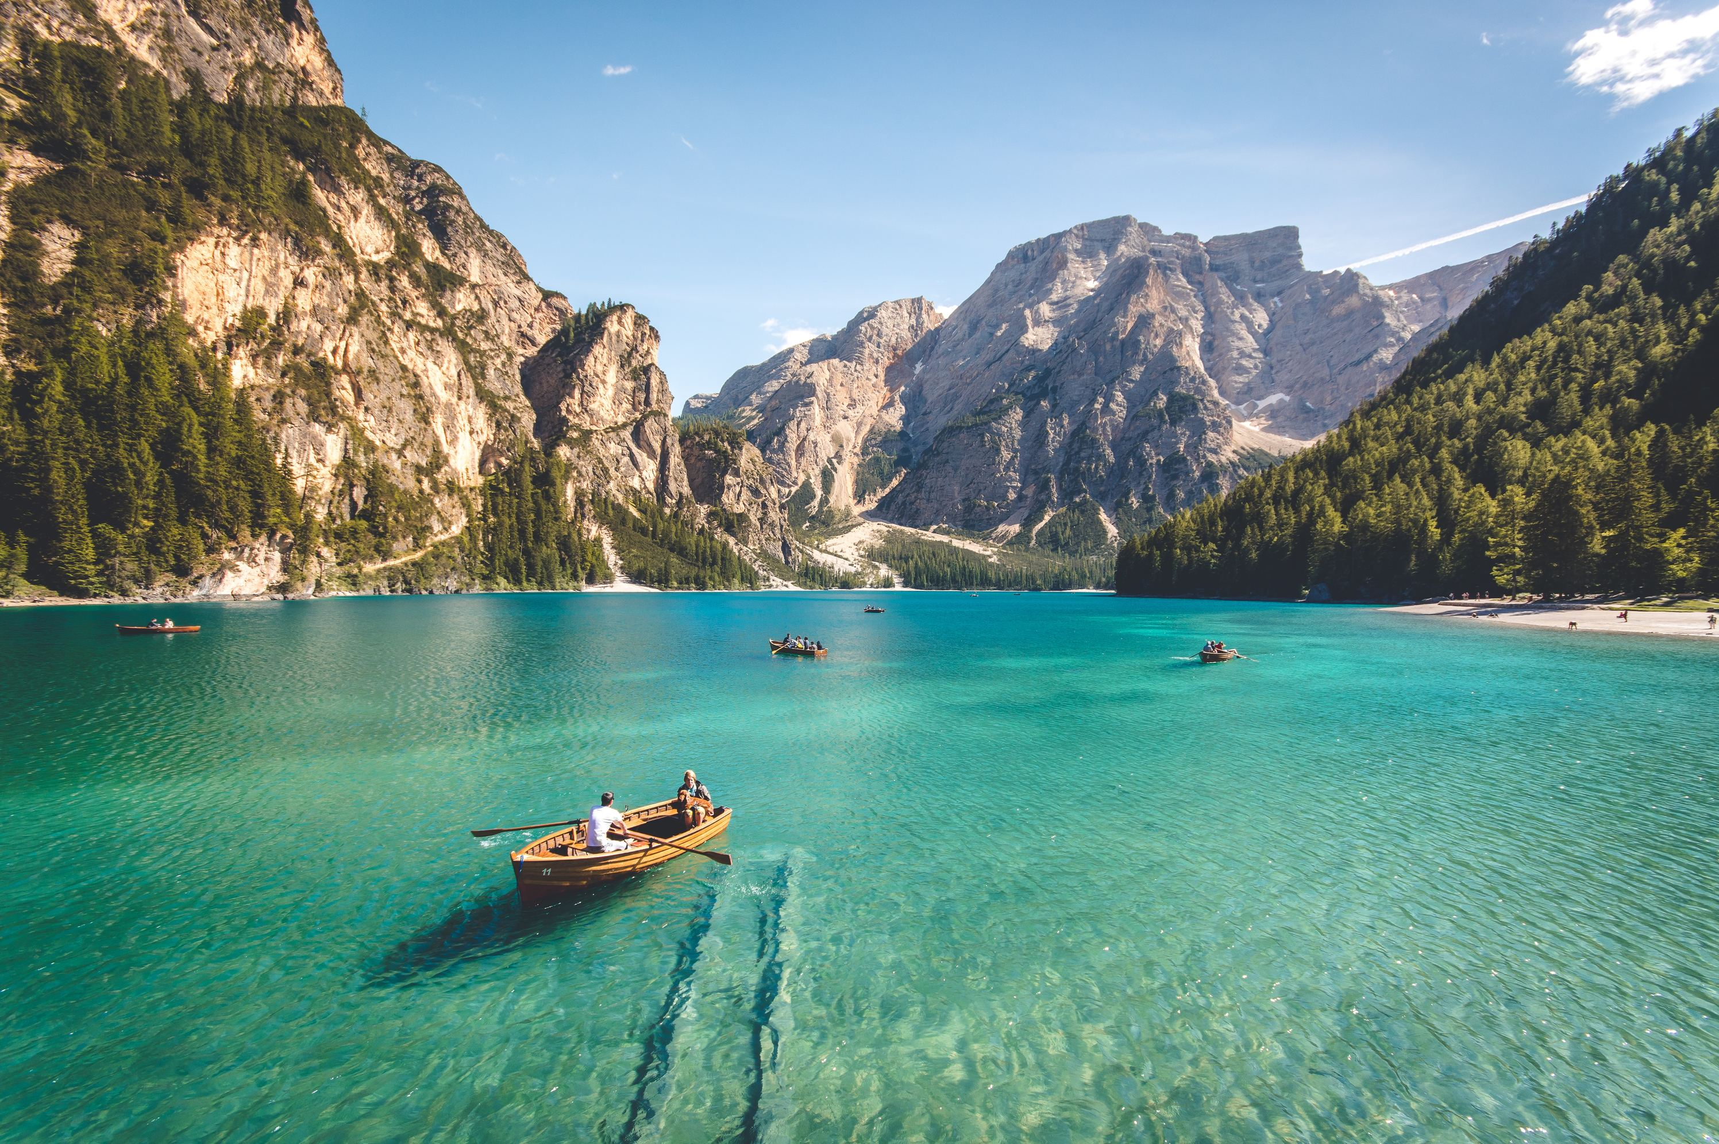
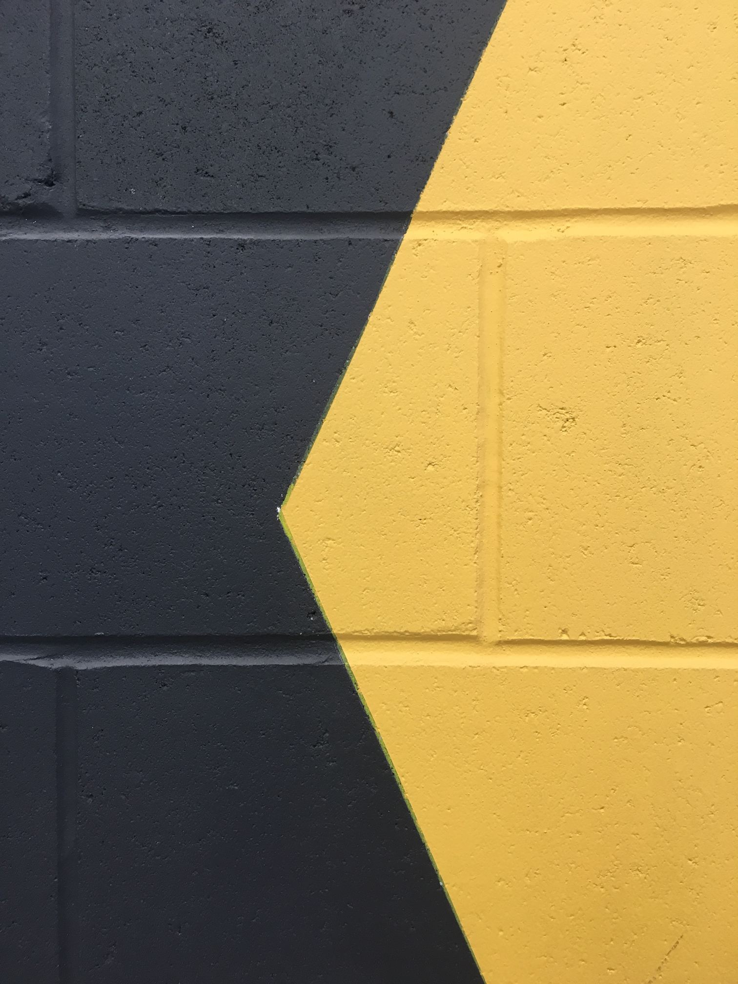

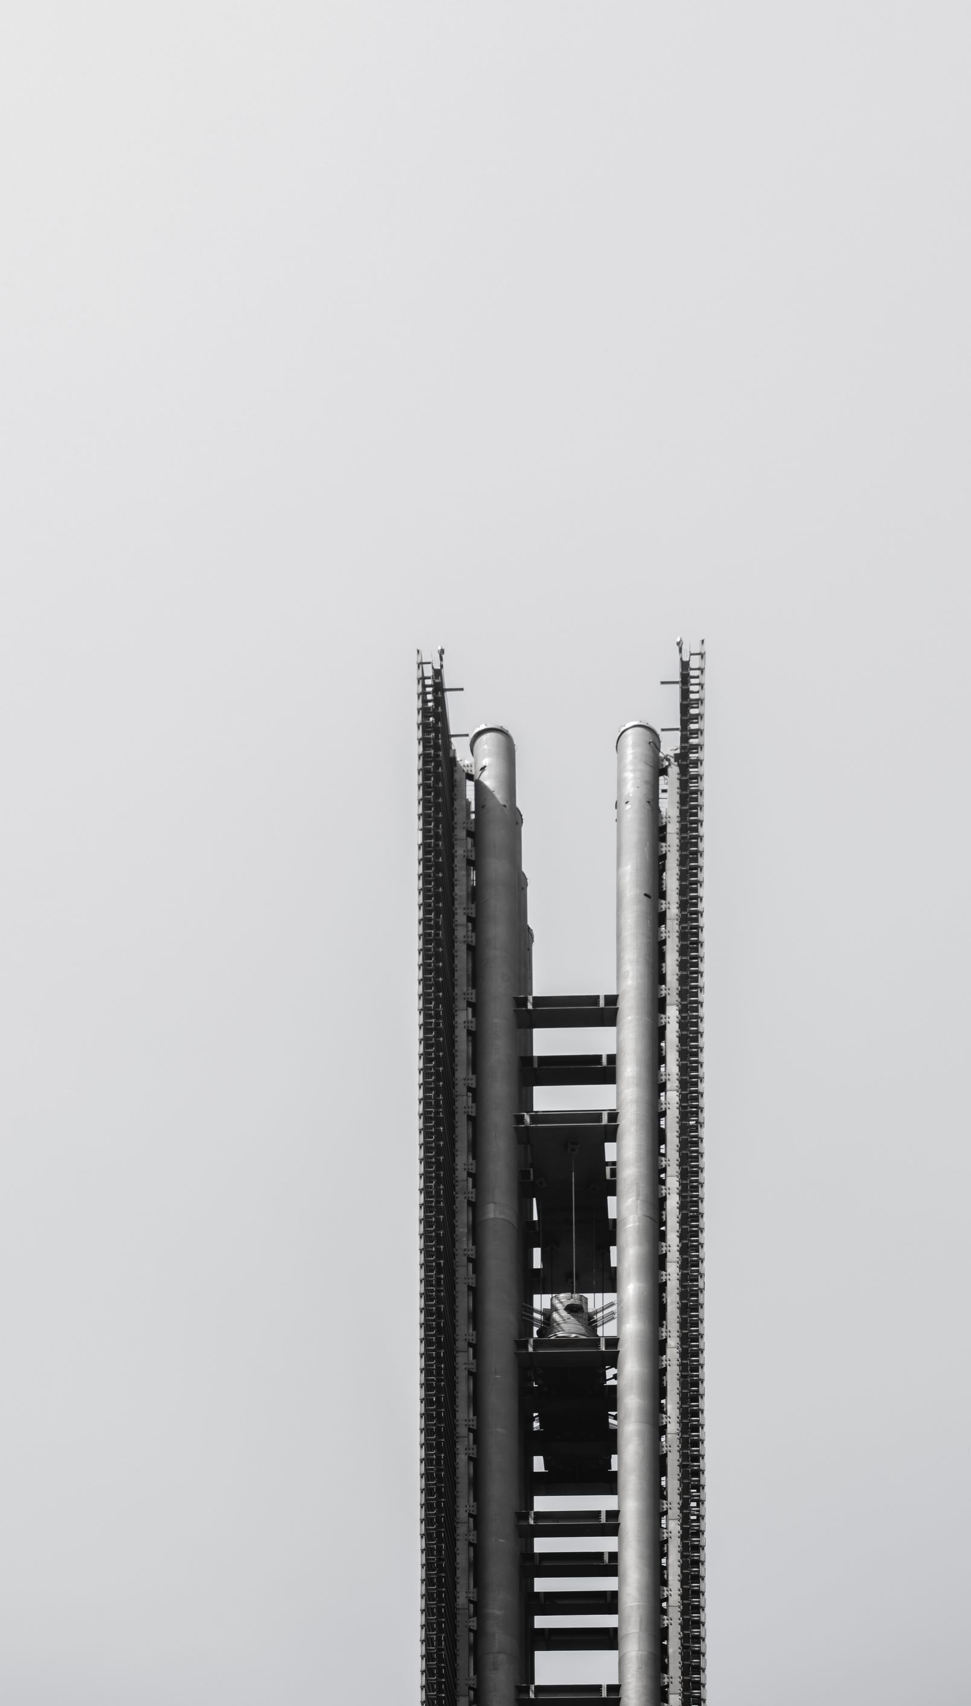
Images used for Testing
Pattern
Landscape
High Contrast

Slide 16
Results (Average Compression Ratio)
Tests:
functionality of Holes-only
Average image size:
1200x800 pixels
Chance of errors being introduced:
0% (No errors)

Slide 17
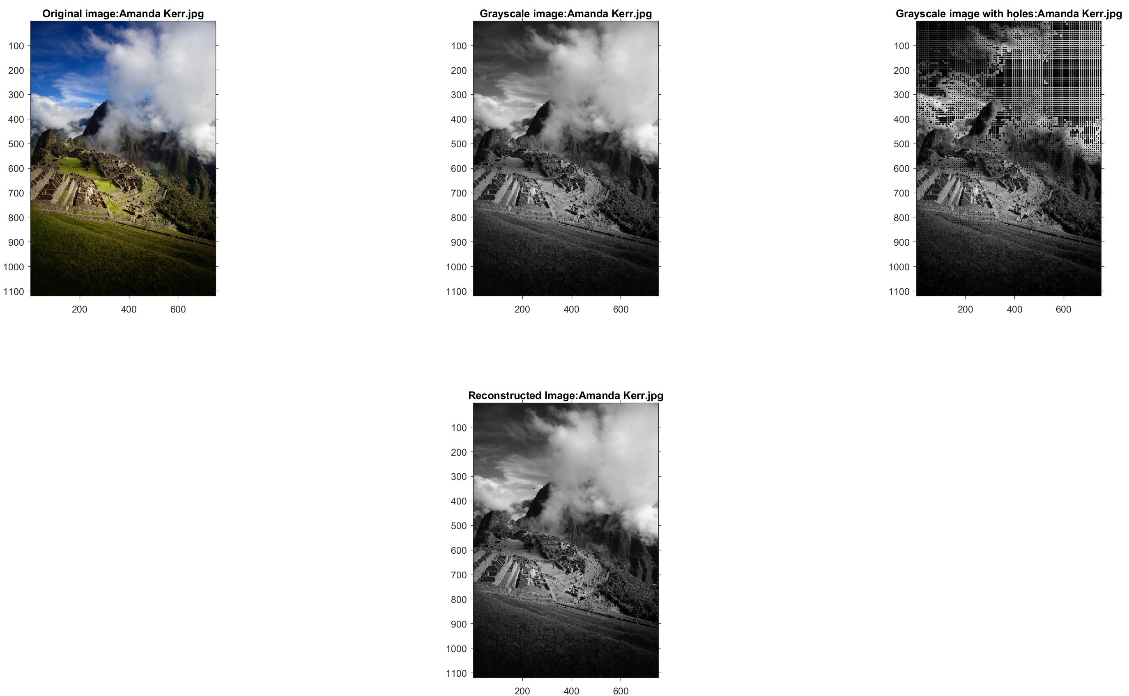
Step-by-Step Process on a Landscape Image

Slide 18
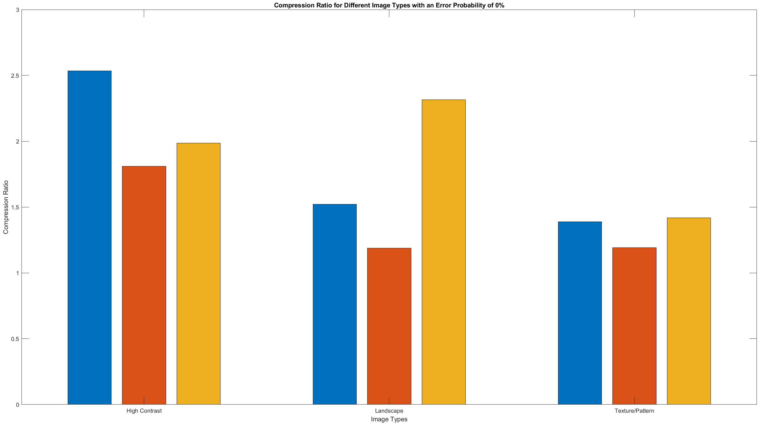
Results (Average Compression Ratio)
Avg = 2.1102
Avg = 1.6753
Avg = 1.3328

Slide 19
Results (Same Image at Different Resolutions)
Tests:
effect of Holes-only algorithm on the compression ratio
Average image size:
2000x1100 pixels
Decreasing in size
Chance of error being introduced:
10%
Bit flip

Slide 20
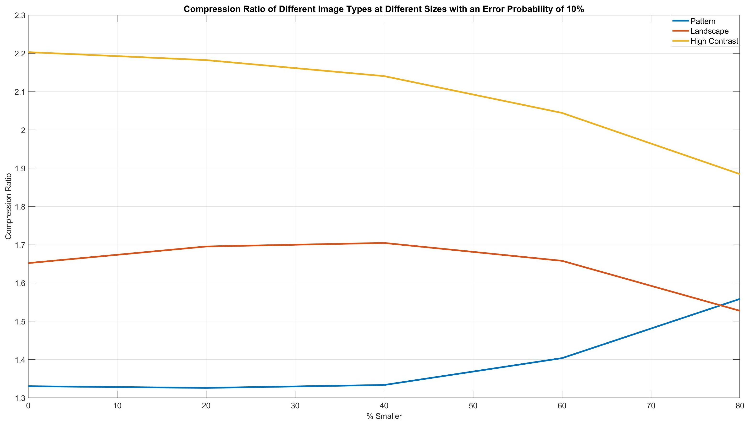
Results (Same Image at Different Resolutions)

Slide 21
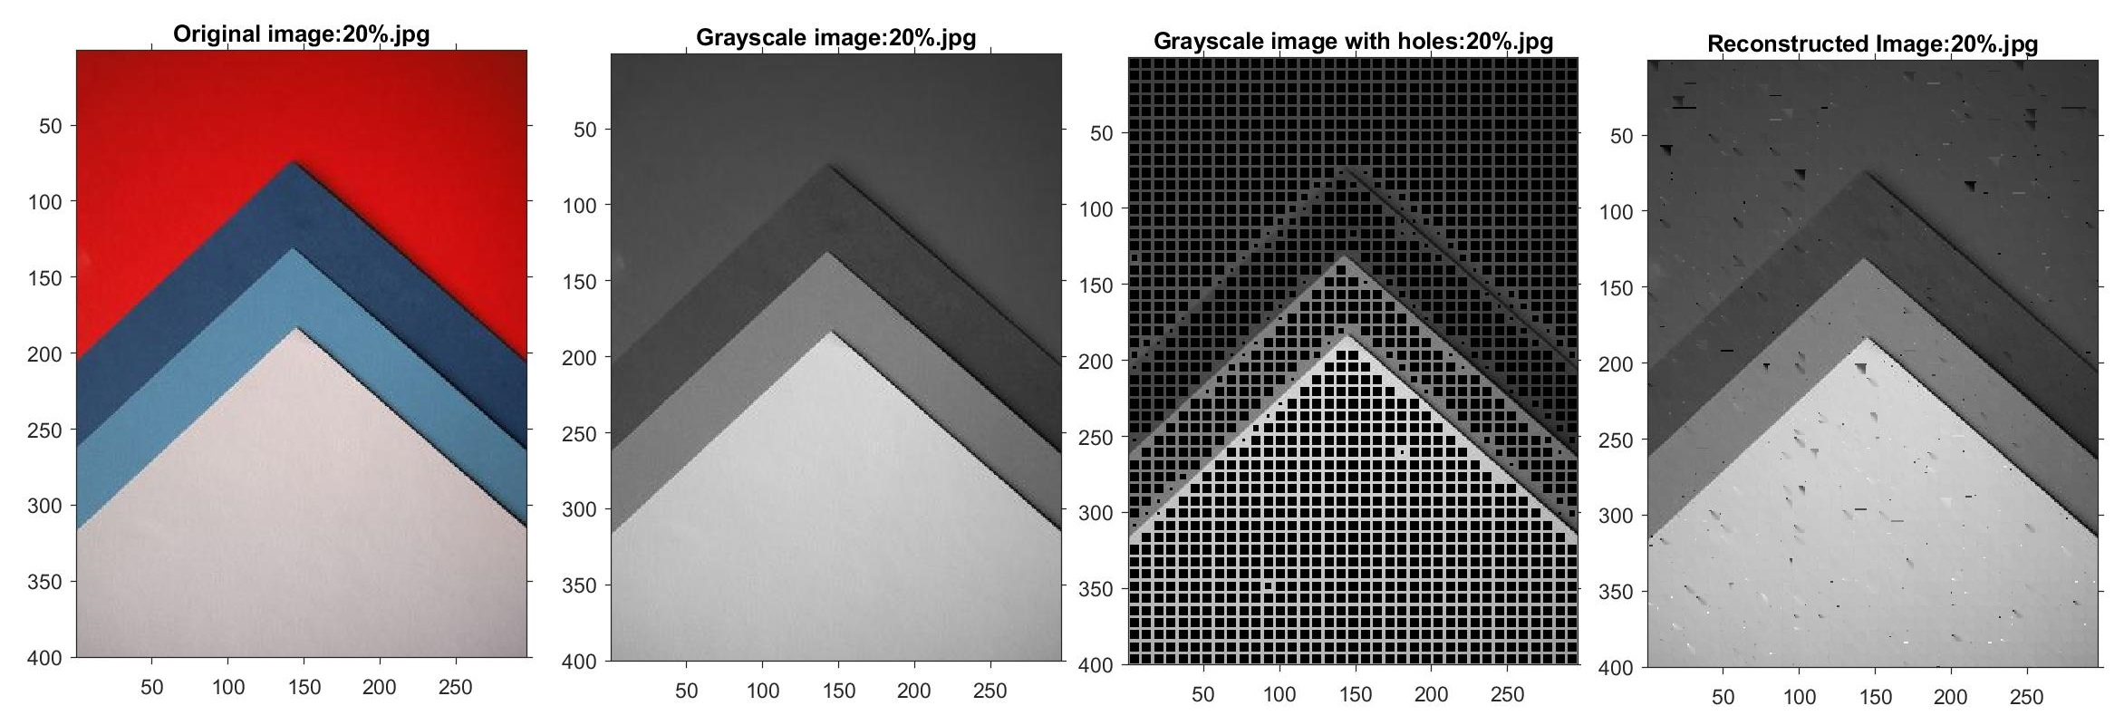
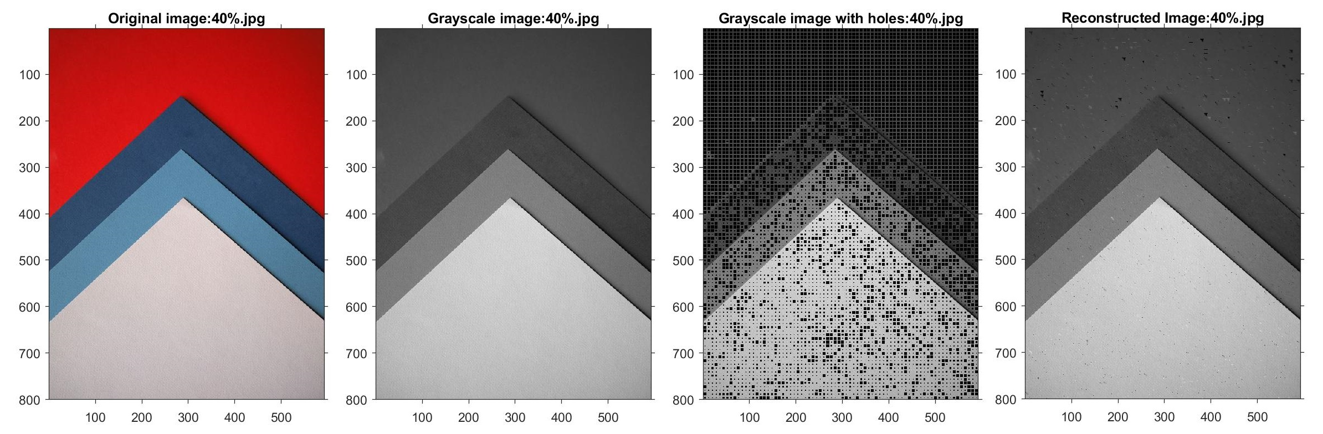

Slide 22
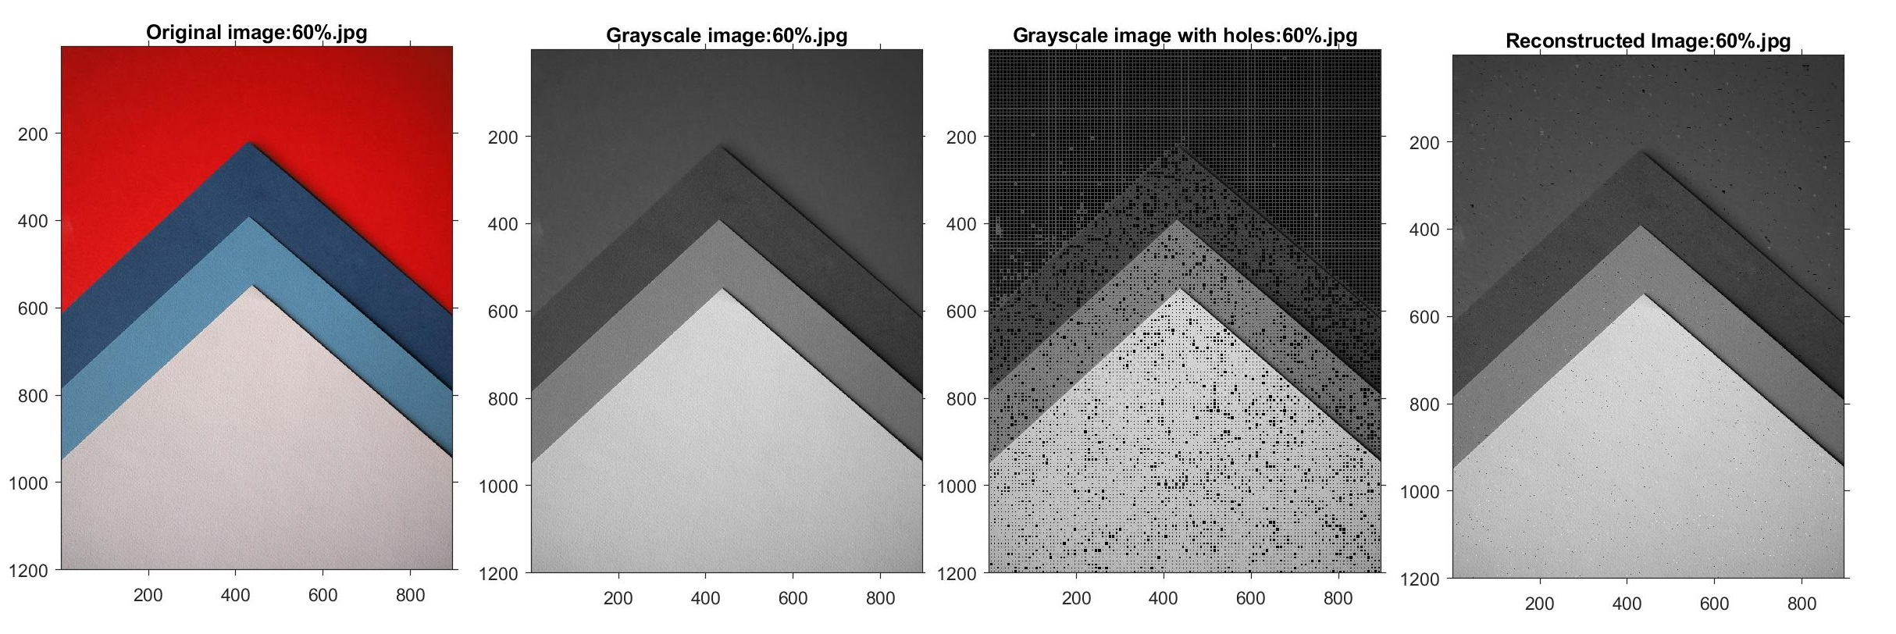
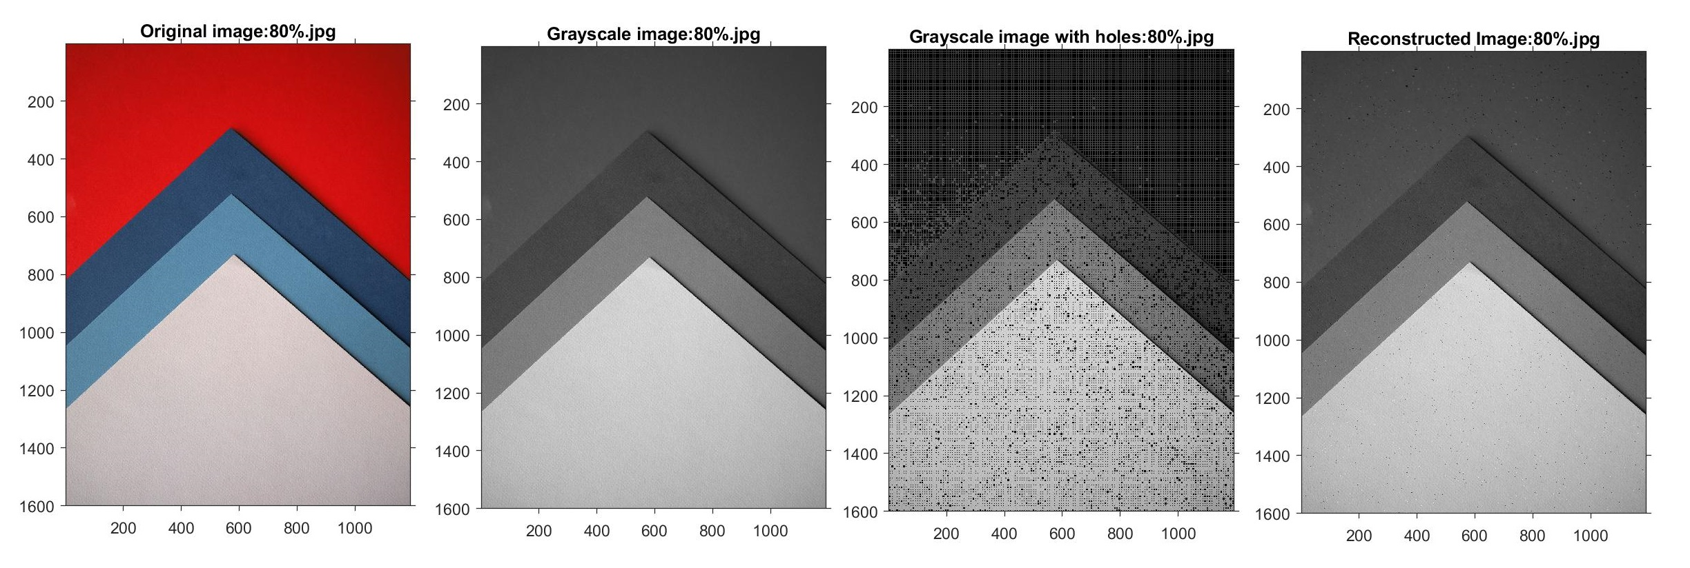

Slide 23
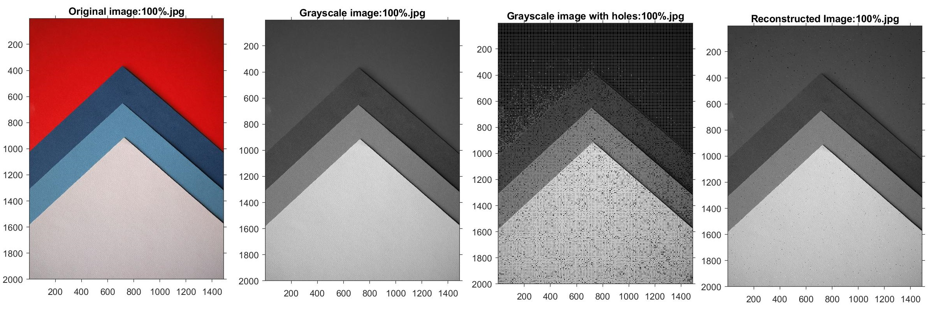

Slide 24
Results (PSNR & MSE)
Tests:
effect of increasing error probability on different image types
Average image size:
1200x800 pixels
Chance of error being introduced:
Increasing from 0% to 100%
Bit flip and Ones compliment introduction

Slide 25
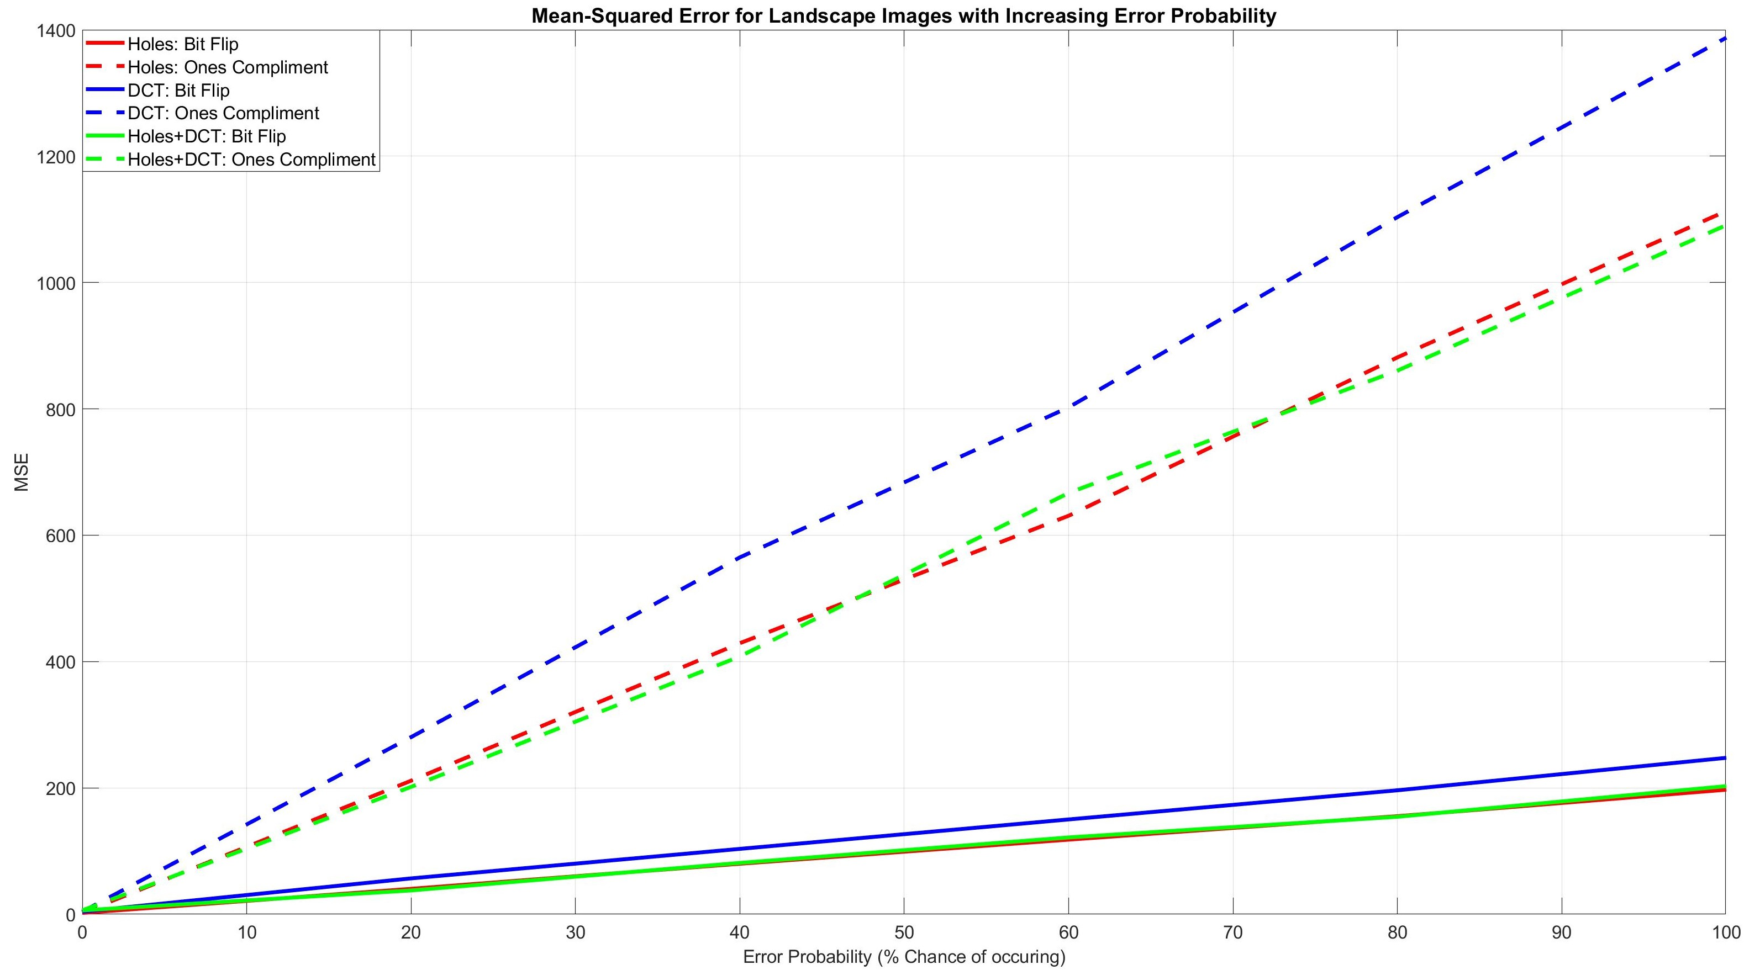
Results (MSE)

Slide 26
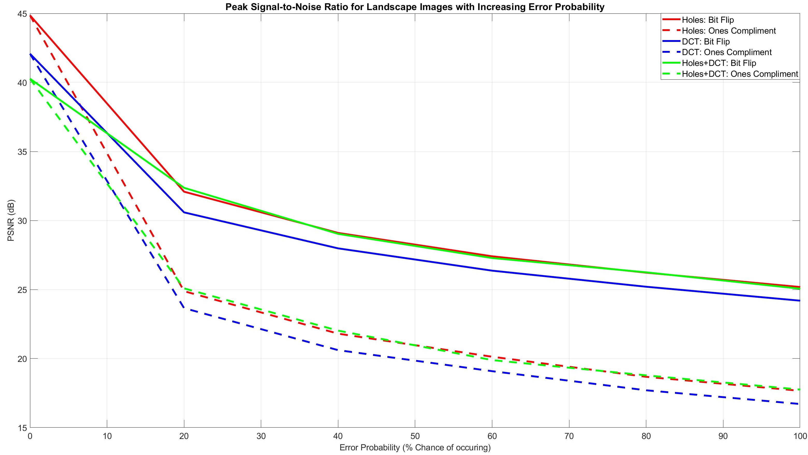
Results (PSNR)

Slide 27
Results (Comparison with DCT & DWT)
Tests:
How does the holes only algorithm perform against DCT and DWT technique
Image size:
Known images
Chance of error being introduced:
10%
Bit flip introduction

Slide 28
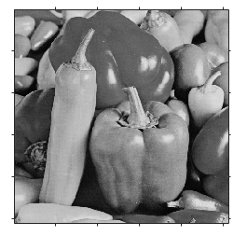
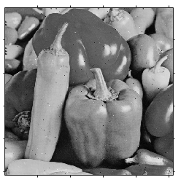
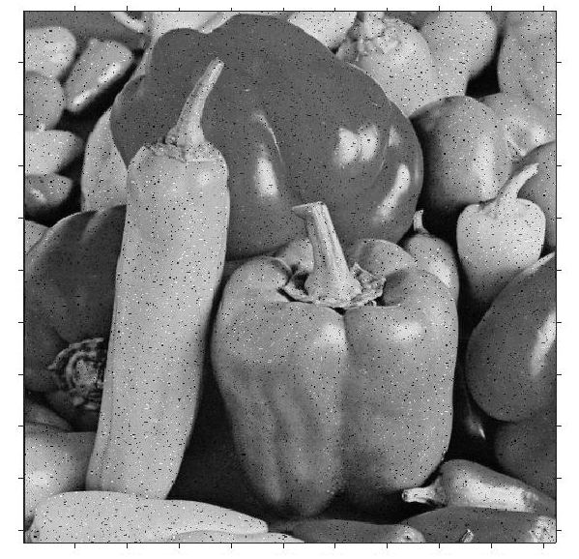
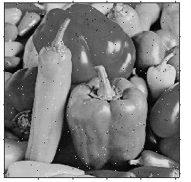
Results (Comparison with DCT & DWT)
Averaged Results with 10% Error
Method | Compression ratio | PSNR | MSE
Holes | 1,15 | 33,20 | 31,71
DCT | 1,09 | 53,02 | 225,81
DWT | 2,57 | 25,22 | 244,60
Peppers: Original
Peppers: Holes
Peppers: DCT
Peppers: DWT

Slide 29
Future Work
Serial programming used → long processing time
Parallel programming
Run Length Encoding → drawbacks
Better encoding scheme
Distance value of 6 → hard coded values
Neural networks (GAN)
Lower resolution → higher resolution

Slide 30
Conclusion
All objectives met within project specifications
Created algorithm:
Functional image compression scheme
Maintains image quality
All images from Unsplash.com

Slide 31
Thank You!
Kishan Narotam Nitesh Nana
Supervisor: Professor Fambirai Takawira

